Slide 1
Writing software for parallel machines
Kees van Reeuwijk

Slide 2
Goal
Get you stared with two tools for parallel programming
OpenMP: a language extension for C and Fortran for fork/join parallelism
MPI: a message passing library, allowing for example the master/worker and data-parallelism patterns
All these terms will be explained

Slide 3
This is a workshop
The goal is to learn by doing
The assignments are per group
I assume you have an account on the Surfsara lisa
We are going to use the C programming language
I will keep things simple, or explain the complicated parts
The hands-on periods also serve as pauses
Complicated questions also in the hands-on periods

Slide 4
Graded assignment: preview
Assignment: write a small program using OpenMP and/or MPI
Per group
You should get some speedup
Code quality will be evaluated
A decent report is required with an objective performance evaluation
More details in the end and in a separate assignment sheet

Slide 5
Outline
Background: why, where & how (overlaps Adam Belloum’s teachings)
What is so special about parallel programming?
Get your own “Hello world” program running on the Lisa cluster
Introduction to OpenMP
Get your own OpenMP program running
Introduction to MPI
Get your own MPI programs running
The graded assignment
The red sections have a hands-on part

Slide 6
Part 1: Background

Slide 7

Why do parallel programming at all?
Inherently distributed: web client/server, collecting data, Internet of Things, communication
Speed! One processor is not enough for me!
Private Eye/Tony Husband

Slide 8

Moore’s law won’t save you any more
Up until about 20 years ago (Pentium 4), for more computing power you could just wait for the next generation of processor
These processors used parallelism behind the scenes, but they still looked like a sequential processor
Now processors are multi-core and multi-threaded, and you have to use parallelism

Slide 9
Parallel hardware: in a compute node
In one compute node:
Possibly multiple CPUs
Multiple cores per CPU
Possibly sub-CPUs
Multithreading
(GPUs)
(Storage nodes)
Core
Core
Core
Core
Cache
Cache
Cache
Cache
Cache
Cache
CPU
CPU
Memory & disk
Compute node

Slide 10
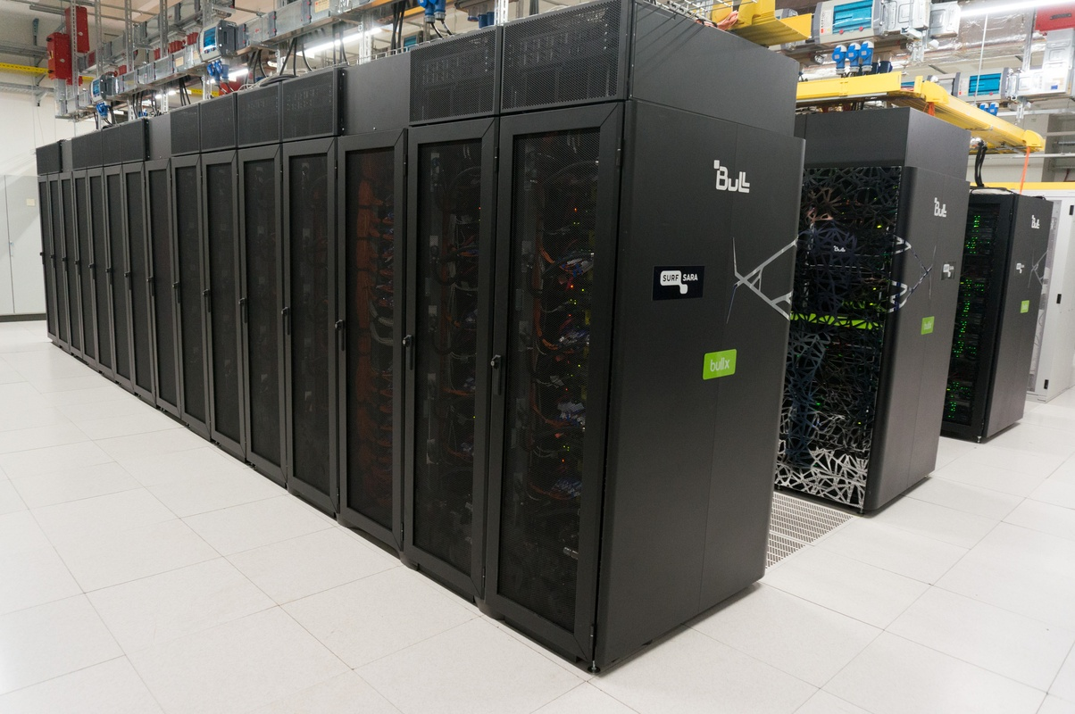
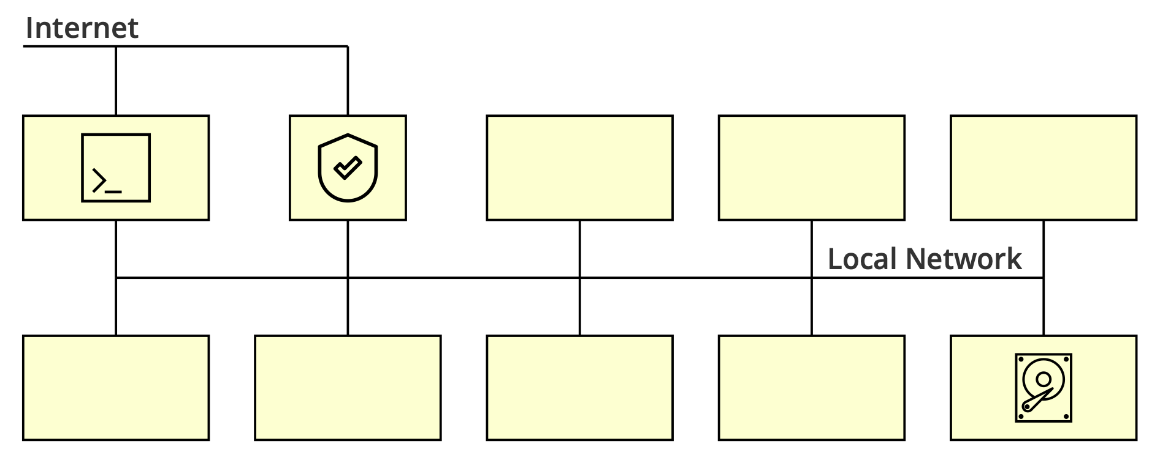
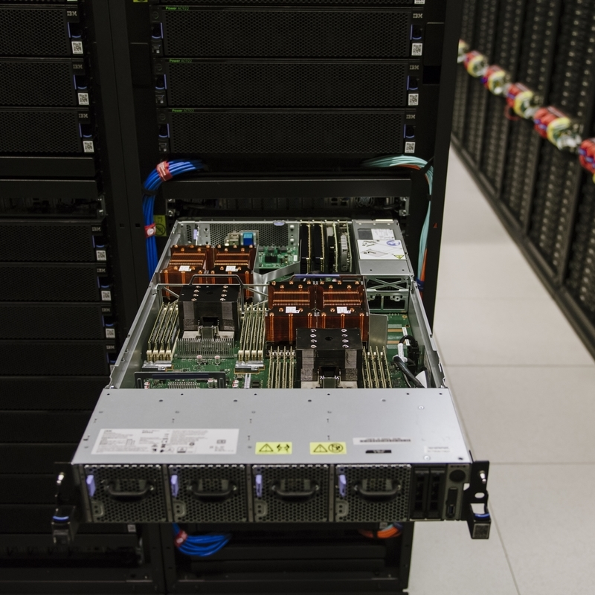
Parallel hardware: clusters
Fast local network
10GB Ethernet
InfiniBand
Head Node(s)
Storage node(s)
SurfSara Cartesius (2016)
Barcelona Supercomputing Center,
MareNostrum 4 (2018)

Slide 11
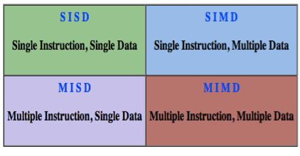
Assumptions
A node has one address space, even with more than one CPU in the node
An address space does not span multiple nodes
Between nodes, message passing is used

Slide 12
Complications
Within an address space, access times are messy
But try to keep accesses local
Not all nodes may be equally powerful
Not all communication may have the same speed
In general: don’t rely on exact timing, things can and will be unpredictable

Slide 13
Programming

Slide 14
Threads: definition
A thread is a single execution sequence
The order of execution is deterministic (only determined by state and input)
The processor is free to change the order of execution, as long as the final observable result is the same
A program with a single thread is a sequential program, the traditional approach
Sequential programs are far easier to understand
A sequential program can only use one core
A program with multiple threads is a parallel program
Threads may, or may not, share the same resources (processor, memory, disk, …)

Slide 15
Creating more threads is easy
thrd_t thread;
thrd_create(&thread, fn, NULL);
Thread t = new Thread(runable);
t.run();
C
Java
… but then what?

Slide 16
Parallel programming is hard!
You have to understand each individual thread
You have to understand the interaction between threads
You have to worry about efficiency
You have to worry about failures
… and what did we just say about exact timing?

Slide 17

Parallel programming is hard!
Finding the parallelism
Race conditions & deadlocks
Efficiency
Portability
Scalability
FOKKE & SUKKE work at the helpdesk
So you only
switched it on…
And then
THIS happened?

Slide 18
Finding the parallelism
(dependencies)
“This step can only be done after that step is finished”
The dependency can be:
A previous step in a sequence
A previous iteration
A computation to determine control flow (if, loop, etc.)
The absence of dependencies allows parallelisation
Not everything can be parallelised
Rewriting may be necessary
a = 12;
b = a + 2;
c = a + 3;
d = b + c;
for(i=1..10)
a[i] = a[i-1]*2;
if (v<0)
d = -2;
else
d = 2;

Slide 19
Race conditions
int primes = 0;
par {
primes += is_prime(5);
primes += is_prime(7);
}
int primes = 0;
par {
primes += 1;
primes += 1;
}
int primes = 0;
par {
primes += 1;
primes += 1;
}
load R0, primes
add R0, 1
store R0, primes
load R0, primes
add R0, 1
store R0, primes
load R0, primes
load R0, primes
add R0, 1
store R0, primes
add R0, 1
store R0, primes
The only correct executions are those where the red and green sequences are executed without interleaving with the other sequence. It is said they should be executed atomically, because they are critical sections.

Slide 20
Race conditions
Watch out when you modify any shared resource
Data in memory
Data in a file
Data in a database
Registers in a peripheral device
…

Slide 21
Atomic operations
We need to protect sections that should be atomic. One solution: mutual exclusion locks
#include <stdatomics.h>
mtx_t lock;
void atomic_add_primes(int n){
mtx_lock(&lock);
primes += n;
mtx_unlock(&lock);
}
par {
atomic_add_primes(is_prime(5));
atomic_add_primes(is_prime(7));
}
#include <omp.h>
par {
#pragma omp atomic
primes += is_prime(5);
#pragma omp atomic
primes += is_prime(7);
}

Slide 22
Deadlock
Multiple locks are useful for efficiency, but be careful to avoid deadlock
void add_three(){
mtx_lock(&lock1);
mtx_lock(&lock2);
primes += 3;
mtx_unlock(&lock2);
mtx_unlock(&lock1);
}
void add_five(){
mtx_lock(&lock2);
mtx_lock(&lock1);
primes += 5;
mtx_unlock(&lock1);
mtx_unlock(&lock2);
}

Slide 23
Deadlock

Slide 24
Efficiency
Keep all your important resources busy:
Processors
Memory banks
Disks
Communication networks

Slide 25
Scalability & Portability
Does your parallel program also work on twice as many processors?
Does your parallel program also work on the next generation of processors?
Does your parallel program also work on that other shiny high-performance platform?
At some point you unavoidably have to say ‘no’, but try to be flexible
Using higher-level frameworks helps!

Slide 26
Communication
Communication is relatively slow: even with fast networks and perfect circumstances it takes at least 1μs (InfiniBand) to 7μs (10GB Ethernet) within a cluster to send a message
Thus you have time to execute thousands of instructions in that time
Long-distance communication is inherently slow: speed of light in glass fiber is about 200.000 km/s, so the Netherlands measures about 1 ms x 1.5 ms, Amsterdam→Paris is 2.5 ms, Amsterdam→New York is 28 ms, and Amsterdam→Tokyo is 46ms
And that’s single-trip, shortest path!
Try to overlap communication and computation

Slide 27
Parallel programming patterns
Ideally, a magic language/compiler would take care of it all, but that is impossible
Nevertheless, to avoid all these headaches of parallel programming, we need simpler programming models, or at least recommended programming patterns
None of these models or patterns is suitable for every problem
None of these models/patterns avoids all problems

Slide 28

Fork/join parallelism
Random thread creation can be messy, structuring helps
Rules:
A thread can be split in a number of threads (fork)
At some point the threads wait for each other to complete (barrier) and a single thread continues (join)
Nesting is allowed
OpenMP supports fork/join parallelism, and we’re going to use it

Slide 29
Master/worker
Work is handed out by a master, work is done by workers
Master or workers can be idle if you’re not careful
Too few workers → master is idle
Too many workers → master overworked → workers idle
It may make sense to have more than one master
Also efficient if some workers are slower: they just do a smaller share of the work
Communication latency
Larger chunks of work
Local work queue
We’ll do an MPI implementation of master/worker, OpenMP also has some support

Slide 30
Data parallel
Each processor is given responsibility for a part of the data; storing it and computations on it (owner computes rule)
All processors execute the same steps, in lockstep as needed
If the computation requires data from other processors, they send that data to the processors that need it
Works best if all processors have roughly the same amount of work, not too much communication
Can be tweaked with well-chosen data distribution
Good fit with message passing: supported by MPI, we’ll do an example

Slide 31


Data distribution - 1D
Which processor owns which element of an array? Many distributions are possible
We only show symmetric distributions, but this can be generalised
block
cyclic
Assign a single block of consecutive elements to each processor. As much as possible, divide equally over the processors
Assign elements one by one to the processors. Repeat as necessary to place all elements.

Slide 32






Data distribution - 2D
For 2D arrays we can apply a distribution to each dimension, or ignore a dimension
block, block
block, *
*, block
cyclic, cyclic
cyclic, *
*, cyclic

Slide 33
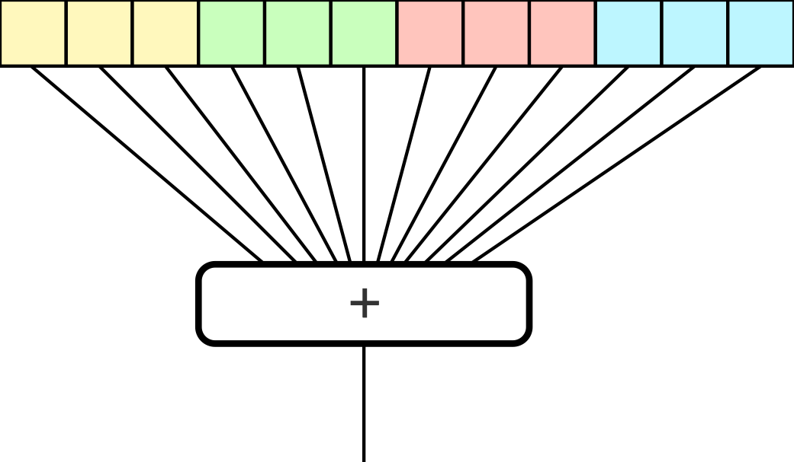
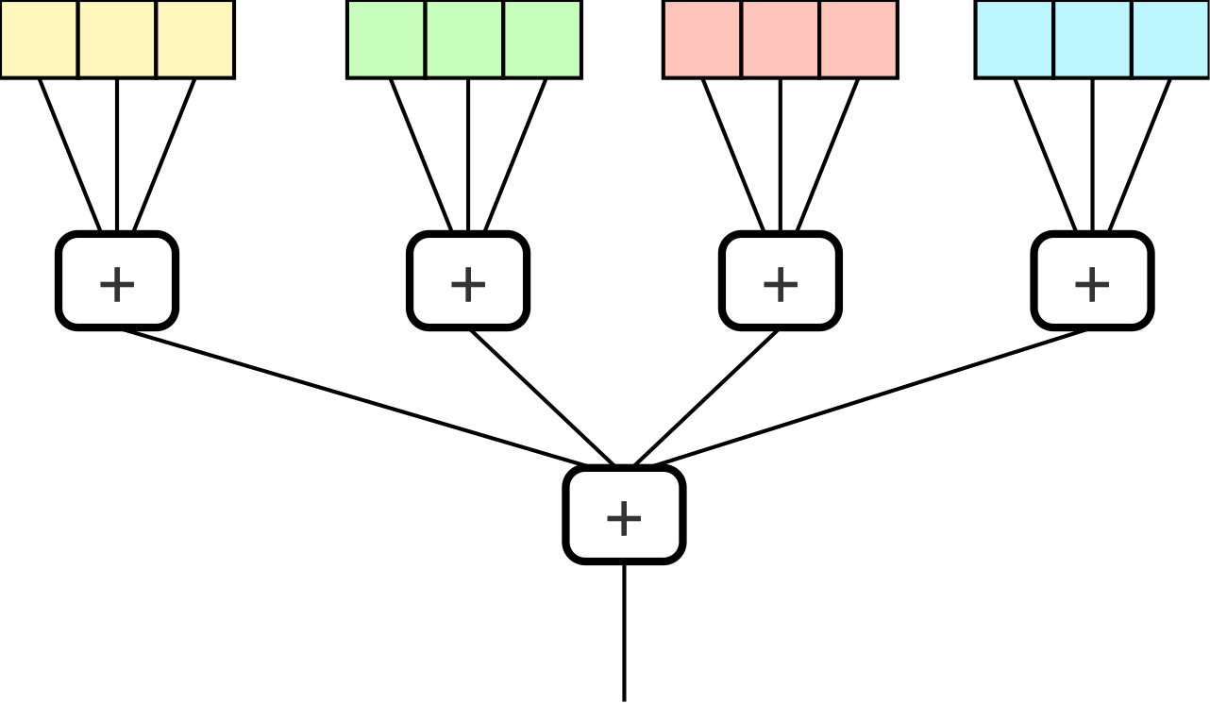
Reductions
Problem: compute sum of the elements of a distributed array
Solution: compute local sum, then add all the subtotals
Similar for product, minimum, maximum, and/or/xor
This is called a reduction
Supported by both OpenMP and MPI

Slide 34
Part 2: Integration in programming languages

Slide 35
Programming languages
OpenMP is a language extension for Fortran, C, and C++
Other languages may have their own way of supporting the same kind of parallelism
MPI is a library for Fortran and C, and many, many, other programming languages
For the hands-on sessions we assume you have some C programming skills
We keep it simple, and will explain the obscure constructs
There are ‘cheat sheets’ available

Slide 36
Pragmas
C has a pragma annotation construct in the preprocessor: #pragma
Pragmas are used in OpenMP
Gives hints to the compiler. The compiler may, or may not use them
Most annotations are compiler-dependent, but there are a few in the standard (C99):
(The example pragma uses hexadecimal floating-point literals, google it to learn more)
#pragma STDC FP_CONTRACT ON
double v = (0x1p512*0x1p512)-0x1p1023;
Allow fused multiply-add, possibly avoiding inf here.

Slide 37
Now let’s run something
As a warmup, let’s compile and run a “hello world” C program on the Lisa
#include <stdio.h>
int main() {
printf("Hello, World!\n");
return 0;
}

Slide 38
Getting the git repository
Log in on lisa, and do:
> module load 2022
> module spider OpenMPI
> module load OpenMPI/4.1.4-GCC-11.3.0
> cd ~
> mkdir lab
> cd lab
> git clone https://github.com/CvR42/parallel-demo.git
> cd parallel-demo
I’ll wait until everyone has cloned the repository.

Slide 39
Compiling and running
> make hello
cc -O3 -Wall -W --std=c11 -lm -o hello hello.c
> ./hello
Hello, World!
> sbatch hello-sbatch.sh
Submitted batch job 14696
> squeue -u $LOGNAME
…
> cat slurm-14696.out
Hello, World!
After that, modify the program to print “Hello, universe!” and compile & submit it again.

Slide 40
Part 3: OpenMP

Slide 41
OpenMP Properties
Assumes shared memory, so only within a single node
fork/join parallelism: split execution into multiple threads, and wait for these threads to terminate
Can be nested
Consists of #pragma annotations and library calls

Slide 42
OpenMP Annotations
The core of OpenMP is a set of parallelisation pragma’s:
Works on the for immediately after it
Divides the iterations over the threads, how is up to the implementation
Sequential execution is still correct
Only recognises for loops with one loop variable, constant bound and increment, and no modification of loop variable in loop
No jumping out of the loop (return, break, goto)
#pragma omp parallel for
for(int i=0; i<1000; i++){
squares[i] = i*i;
}

Slide 43
Parallel sections
The threads can also do completely different things:
#pragma omp parallel sections
{
#pragma section
{ primes += is_primes(5); }
#pragma section
{ primes += is_primes(7); }
}

Slide 44
Shared and private
Variables can be public between threads or private to an iteration
Obvious default: everything within parallel section is private, everything outside is public
Can be changed in the pragma declaration:
#pragma omp parallel for public(b) private(v)
int a[100];
int b = 33;
#pragma omp parallel for
for (int i=0; i<100; i++){
int v = 2*i + b;
a[i] = v;
}

Slide 45
Reduction variables
Reduction variables get special treatment: local and public
int sum = 0;
#pragma omp parallel for reduction(+:sum)
for (int i=0; i<100; i++)
sum += a[i];

Slide 46
Availability OpenMP
Shared-memory parallelism for Fortran, C, and C++
See openmp.org
Now at version 5.2 of Nov 2021. Version 5.1: Nov 2020, Version 5.0: Nov 2018
At least some version supported by many standard compilers, in particular GCC family (GCC 12: OpenMP 5.1, partially), Intel C/Fortran (5.1, ‘most’), LLVM (Clang, Flang): OpenMP 5.1 (partially)
Can even deal with nested and other complicated parallelism structures, but that’s advanced
Bindings for other languages are problematic: requires compiler support

Slide 47
Part 4: Running OpenMP

Slide 48
Your mission…
Count the number of primes in a range of integers, using OpenMP to speed up.
First I give you the main() function.
int main(void) {
const long int base = 10000000000001L;
const long int r = 400000;
int primes = 0;
for (long int n = base; n < base + r; n += 2) {
bool prime = is_prime(n);
if (prime) {
primes++;
}
}
printf("There are %d primes between %ld and %ld.\n", primes, base, base + r);
return 0;
}

Slide 49
The is_prime() function
/* Given an integer ’n’, return ‘true’ iff ’n’ is prime. */
bool is_prime(long int n) {
if (n < 2) {
return false; // By definition
}
if ((n % 2) == 0) {
return n == 2; // There is only one even prime: 2
}
const long int top = (long int) ceil(sqrt(n));
for (long int k = 3; k <= top; k += 2) {
if ((n % k) == 0) {
return false;
}
}
return true;
}

Slide 50
Compiling and running an OpenMP program
Edit primes-omp.c to parallelise it
Compile it to a runnable program with: make primes-omp
Submit job with: sbatch primes-omp-sbatch.sh
Check the work queue with: squeue -u <login-name>
Look at slurm-xxxx.out for the result of the run (There should be 67001 primes)
Write down the number of threads used, and the computation time
Edit the line OMP_NUM_THREADS=X in primes-omp-sbatch.sh to run with a different number of threads and go to step 3

Slide 51
Timing
Don’t bother with 1 or 2 cores!
Cores | Time (s) | Speedup | Efficiency
1 | 861.0 | 1.00 | 1.0
2 | 436.8 | 1.97 | 0.99
4 | 229.9 | 3.75 | 0.94
6 | 156.5 | 5.50 | 0.92
8 | 119.5 | 7.21 | 0.90
12 | 88.7 | 9.71 | 0.81
16 | 73.3 | 11.75 | 0.73

Slide 52
Part 5: MPI

Slide 53
Message Passing Interface
MPI (Message Passing Interface) is a library for communication with explicit messages
Intended for computations with multiple nodes
May even make sense within a node, may be implemented with shared memory
Or: it may be combined with OpenMP
Usually requires cooperation between the two parties: send operation must have a matching receive operation
Supported on many machines, different implementations
Optimised for large amounts of data across reliable networks (preferably symmetric)

Slide 54

Communicators, rank
Every MPI process belongs to one or more communication groups
The default communication group MPI_COMM_WORLD contains all processes
The group is passed to almost all MPI functions
Each group has a size, all processes in a group have a unique rank in the range [0,size〉
size
int rank, size;
MPI_Comm_rank(MPI_COMM_WORLD, &rank);
MPI_Comm_size(MPI_COMM_WORLD, &size);

Slide 55
Send and receive
double vector[SZ];
MPI_Status status;
MPI_Send(vector, SZ, MPI_DOUBLE, <dest>, 0, MPI_COMM_WORLD);
MPI_Recv(vector, SZ, MPI_DOUBLE, MPI_ANY_SOURCE, 0, MPI_COMM_WORLD, &status);
Send an array of data to a receiving process
Receive an array of data from a sending process
Receiver may specify MPI_ANY_SOURCE, sender is put in a field in status
Similarly, receiver may specify MPI_ANY_TAG, tag is put in a field in status
For small messages MPI_Send() will return immediately, for large messages an MPI_Recv() has to receive the data before MPI_Send() returns
Functions return an error code. We ignore those which is BAD, BAD, no good at all

Slide 56
Send/receive
double send_vector[SZ], recv_vector[SZ];
MPI_Status status;
MPI_Sendrecv(send_vector, SZ, MPI_DOUBLE, <dest>, 0,
recv_vector, SZ, MPI_DOUBLE, <src>, 0, MPI_COMM_WORLD, &status);
Send and receive in one call
There ordering of the operations is left to the implementation, may avoid deadlock
Send and receive buffers cannot overlap
Source and destination may be different, also size and even data type

Slide 57
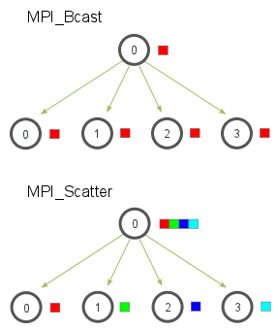
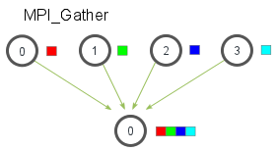
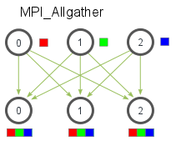
Collective communication patterns
Reduction
Broadcast
Scatter
Gather
All gather
Pictures: mpitutorial.com

Slide 58
Availability MPI
Message-passing library for Fortran, C, and C++
Three implementations on Lisa:
Open MPI, open-mpi.org
MPICH mpich.org
Intel compiler
Bindings libraries for Python, Java, Rust, Haskell, Perl, Mathematica, …

Slide 59
Part 6: Running MPI

Slide 60
Your mission…
Count the number of primes in a range of integers using MPI. See primes-mpi.c
Use master/worker pattern:
Workers wait for a number, compute is_prime(), send back result, repeat
A worker stops if it is sent 0 as the number
The master distributes work over workers
The node with rank 0 is master, the other nodes are workers
We give you initialisation, communication helpers, all worker code, and other bureaucracy
You have to add communication code to the function run_as_master()

Slide 61
Solution: worker
Accept work messages, send back results, until told to stop.
void run_as_worker(void){
while(true){
int val;
await_command(&val);
if (val == 0 ) {
break;
}
int result = is_prime(val);
send_result(result);
}
}

Slide 62
Solution: master
Send numbers to test to all workers until work is exhausted, then shut down workers
int run_as_master(int worker_count, long int startval, long int nval){
int active_workers = 0, primes = 0;
long int val = startval, endval = startval + nval;
for (int worker = 1; worker <= worker_count && val <= endval; worker++){
send_work_command(worker, val);
val += 2;
active_workers++;
}
while (active_workers > 0) {
int worker, result;
/* insert communication */
primes += result;
if (val <= endval) {
/* insert communication */; val += 2;
} else {
/* insert communication */; active_workers—;
}
}
return primes;
}

Slide 63
Compiling and running an MPI program
Edit primes-mpi.c to parallelise it: search for /* insert communication */
Compile it to a runnable program with: make primes-mpi
Submit job with: sbatch primes-mpi-sbatch.sh
Look at slurm-xxxx.out for the result of the run (there should be 67001 primes)
Write down the number of workers used, and the computation time
Edit the specification -N 1 in primes-mpi-sbatch.sh to run with a different number of nodes, and go to step 3

Slide 64
Solution: master
Send numbers to test to all workers until work is exhausted, then shut down workers
int run_as_master(int worker_count, long int startval, long int nval){
int active_workers = 0, primes = 0;
long int val = startval, endval = startval + nval;
for (int worker = 1; worker <= worker_count && val <= endval; worker++){
send_work_command(worker, val);
val += 2;
active_workers++;
}
while (active_workers > 0) {
int worker, result;
await_result(&worker, &result);
primes += result;
if (val <= endval) {
send_work_command(worker, val); val += 2;
} else {
send_work_command(worker, 0); active_workers—;
}
}
return primes;
}

Slide 65
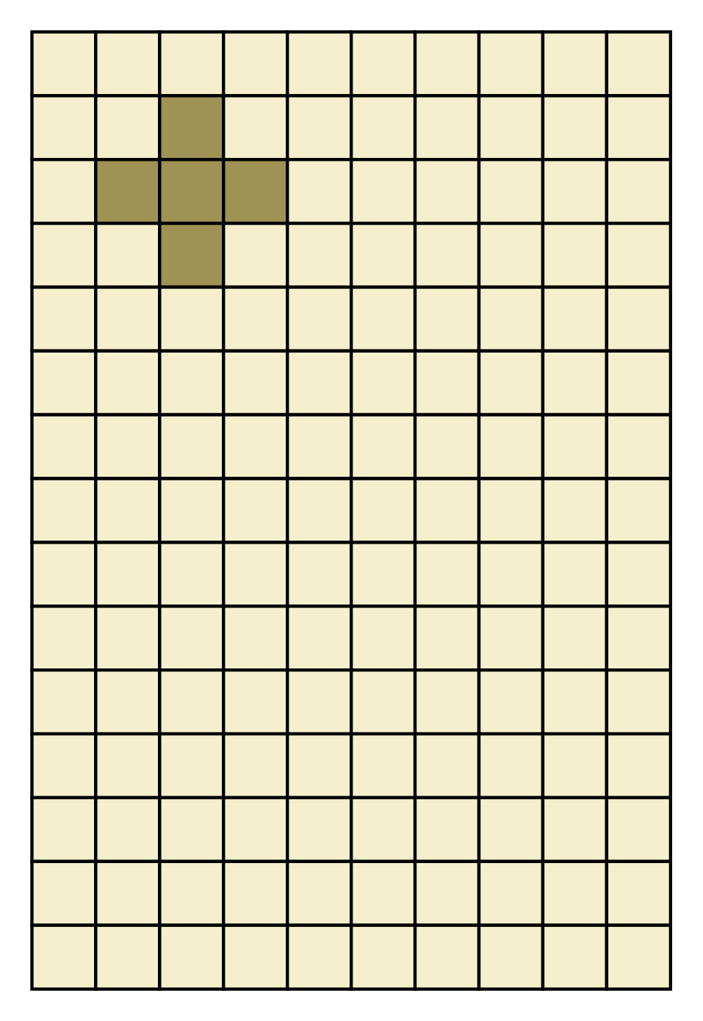
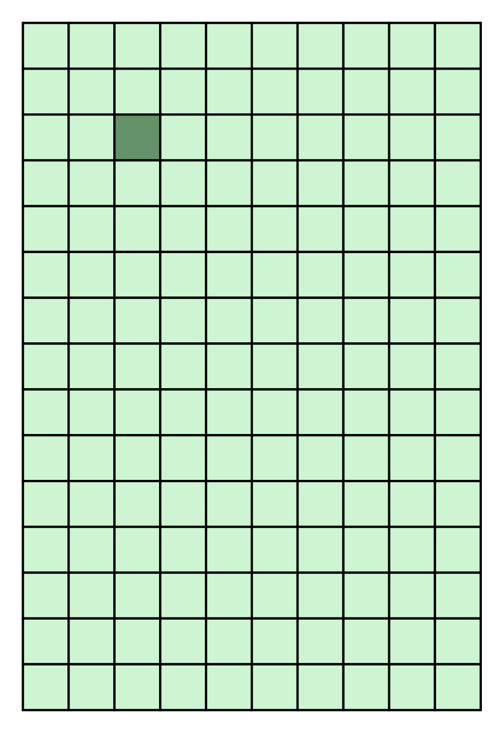
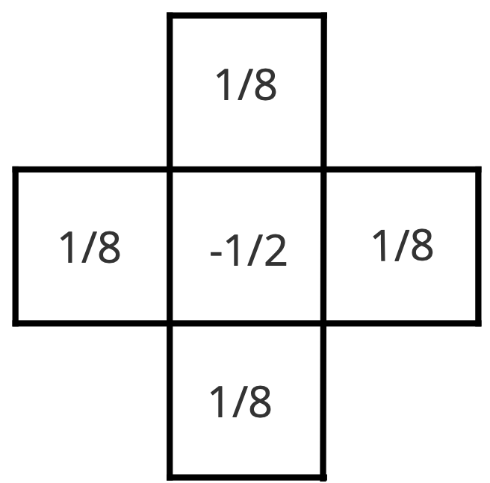
Stencil operations
Role of the arrays is swapped after each iteration
Typical for diffusion computations (including weather prediction)

Slide 66

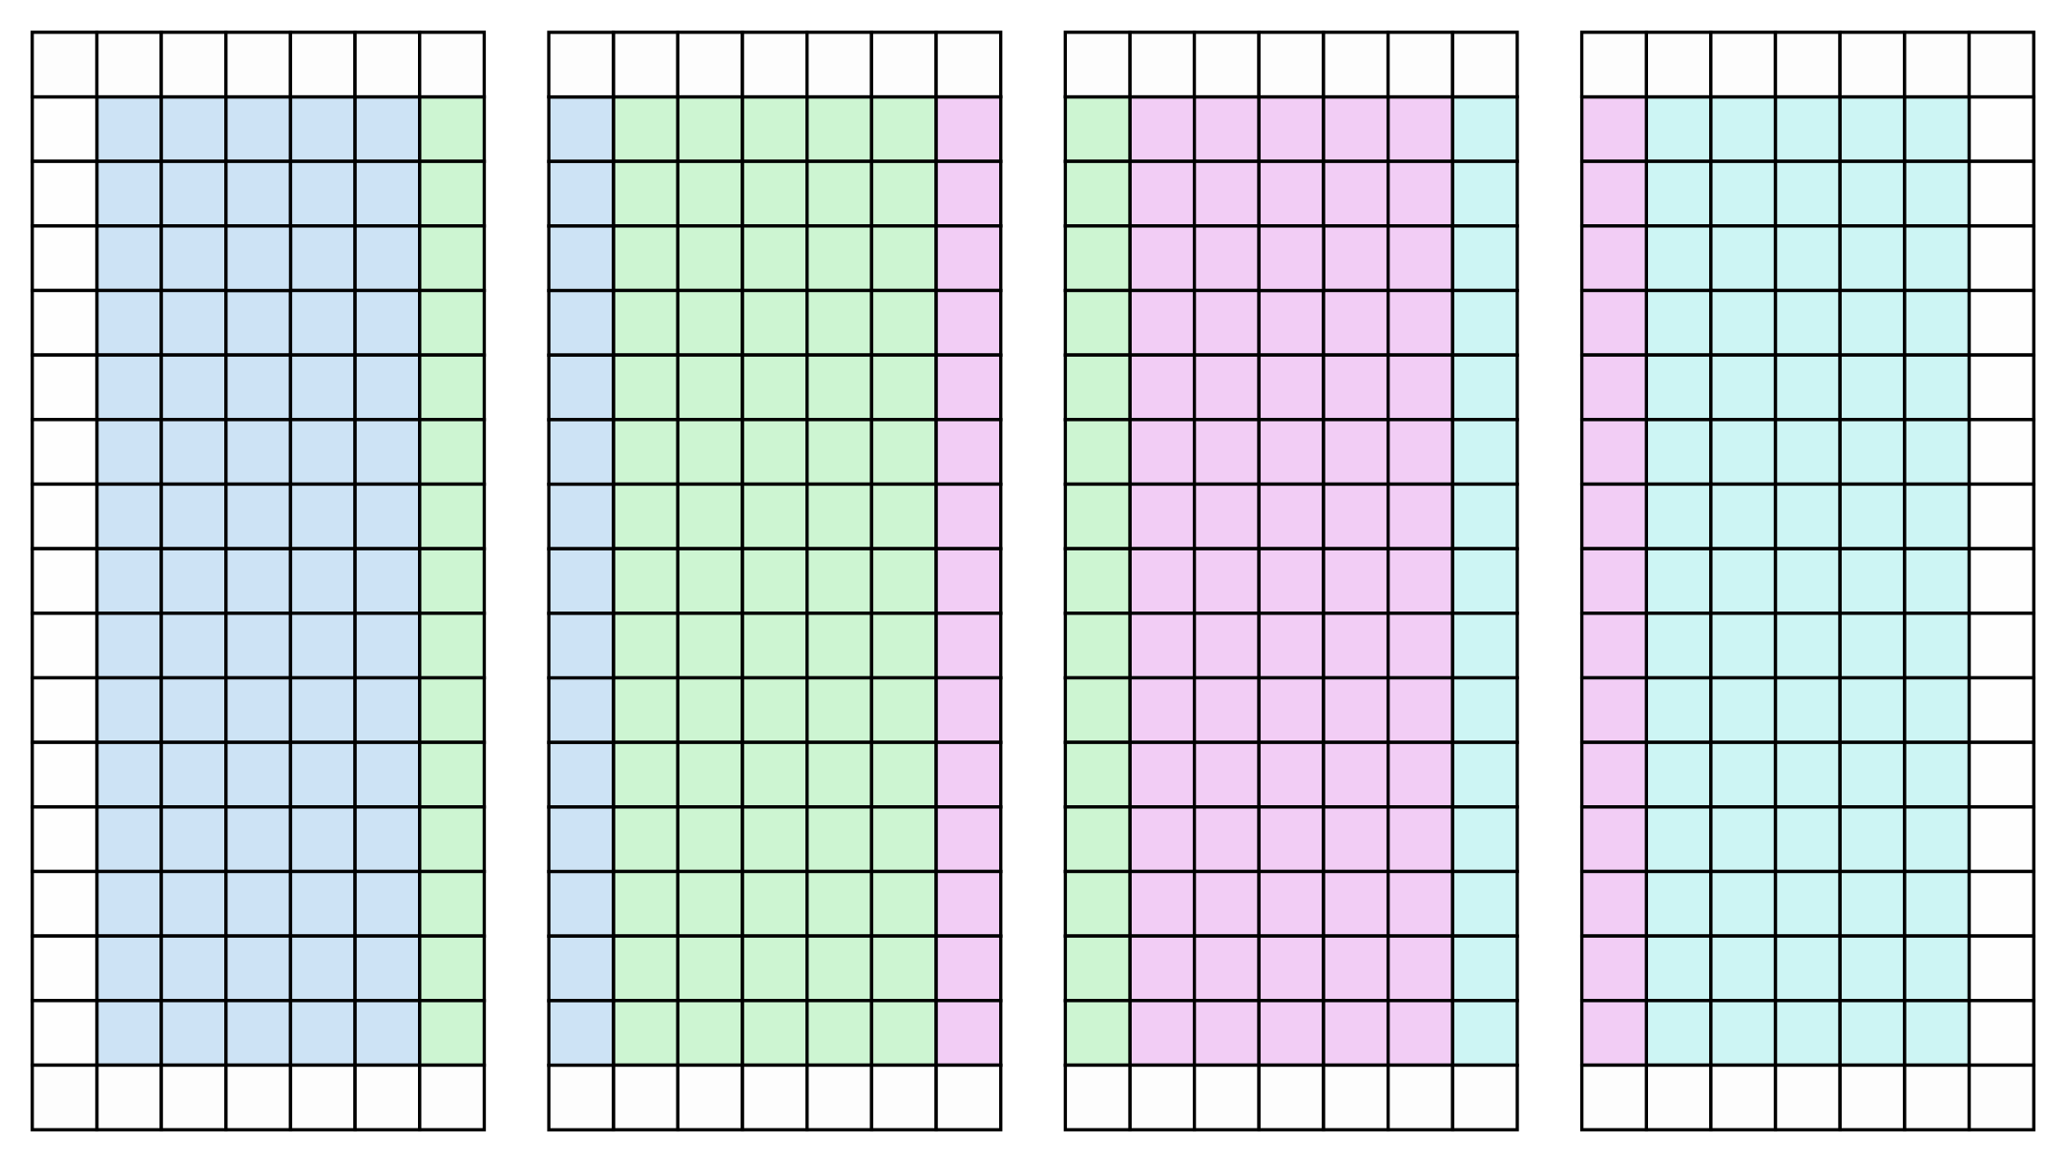

Parallel stencil
Block distribution over processors
Requires border cells

Slide 67
The communication
void exchange_columns(const int proc, double *cells, const int send_col, const int recv_col)
{
double *send_buffer = &cells[compute_index(0, send_col)];
double *recv_buffer = &cells[compute_index(0, recv_col)];
// Add code to send and receive columns here
// Hints: use a tag value of 0, use MPI_COMM_WORLD
}
Use the official documentation (I’ll give a pointer)

Slide 68
Compiling and running an OpenMP program
Edit the function exchange_columns() in stencil-mpi.c. Add code to send and receive columns
Use https://www.open-mpi.org/doc/current as reference
Compile it to a runnable program with: make stencil-mpi
Submit job with: sbatch stencil-mpi-sbatch.sh
Look at slurm-xxxx.out for the result of the run (25 iterations in less than a second)

Slide 69
Now let’s scale up…
Edit stencil-mpi.c to go from 100 rows to 1000 rows
Compile it to a runnable program with: make stencil-mpi
Submit job with: sbatch stencil-mpi-sbatch.sh
Look at slurm-xxxx.out for the result of the run

Slide 70
DEADLOCK?!?
MPI_Send() may block until data is received!
Who is going to do the receiving?!?
What is going on here?
Everyone sends to left neighbour (if any)
Everyone receives from left neighbour (if any)
Everyone sends to right neighbour (if any)
Everyone receives from right neighbour (if any)

Slide 71
Solution
Arrange that even-numbered processors first send, then receive, odd-numbered processors first receive, then send
Use MPI_Sendrecv() and let the implementation determine who sends first
Use special MPI_Isend() that never blocks
You’ll have to wait explicitly later on to ensure communication is finished

Slide 72
Using MPI_Sendrecv()
void exchange_columns(const int proc, double *cells, const int send_col, const int recv_col)
{
MPI_Sendrecv(&cells[compute_index(0, send_col)], ROWS, MPI_DOUBLE, proc, 0,
&cells[compute_index(0, recv_col)], ROWS, MPI_DOUBLE, proc, MPI_ANY_TAG,
MPI_COMM_WORLD, MPI_STATUS_IGNORE);
}
Avoids deadlock
Inefficient, because everyone looks left first, so communication between processors is not parallel.
Can be solved by an odd/even pattern

Slide 73

Milestone!
You may have written your first parallel program
You have written and run your first OpenMP program
You have written and run your first MPI program
You may have created your first race condition
You may have created your first deadlock
Debagarh (in Odia language), also known as Deogarh, is a city in Odisha state of eastern India. Located in the North-Western region of the state, it is the headquarters of Debagarh District that was created on 1 January 1994, after being bifurcated from Sambalpur District.
(Source: wikipedia)

Slide 74
Part 7: Assignment

Slide 75
Game of life
Group assignment, deadline 30 januari(?)
A board of 3000x3000, 5000 generations
A passing grade requires at least a speedup of 3 on 16 processors/threads
1 bonus point for a speedup of at least 10 on 16 processes/threads
1 bonus point for a speedup of at least 17
Write a report containing the full, commented, code of the implementation, a motivation of your chosen distribution and communication method, and a discussion of the performance
See Assignment.md for more details, requirements, and hints

Slide 76
Warnings
Take error handling serious, or you’ll lose points
Clusters like the Lisa are used intensively, plan accordingly

Slide 77
Endianness
0x55AA can be stored in memory in two ways:
55 AA
big-endian: most significant byte has lowest address
AA 55
little-endian: least significant byte has lowest address
x86 and AMD64/x86-64 are little-endian
ARM processors supports both
for 32-bit numbers other orderings are sometimes also used
short a = 0x55AA; char *p = (char *) &a; printf(“The bytes are %02x and %02x\n”, p[0], p[1]);

Slide 78
MPI in heterogeneous systems
Now suppose that you send an array of shorts from a big-endian to a little-endian processor
No problem, as long as you tell MPI what you’re sending!
short vector[SZ];
MPI_Send(vector, SZ, MPI_SHORT, 2, 0, MPI_COMM_WORLD);
MPI_Recv(vector, SZ, MPI_SHORT, MPI_ANY_SOURCE, 0, MPI_COMM_WORLD, &status);

Slide 79
Data size and other complications
Structs can also be sent by telling MPI about the layout
The C language does not specify how many bits there are in an int, char, long int, etc.
Things like 12-bit chars or 36-bit ints are allowed (but very rare)
Signed values are not necessarily two’s complement
Floating-point numbers are not necessarily according to the IEEE-754 standard (but almost always are)

Slide 80

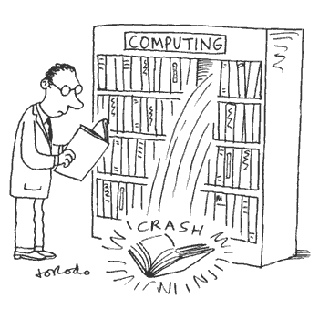
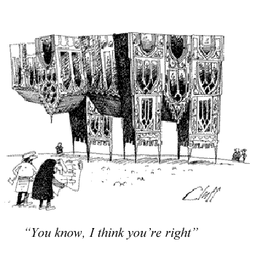
Programming hazards

